Slide 1

IMO RIVER GAS LIFT HEALTH CHECK WORKSHOP

Slide 2
AGENDA

Slide 3
WORKSHOP OBJECTIVE
Carryout a Health Check of Imo River Gaslift system
Share a common understanding on the Status of :
Surface/Subsurface Facilities (Physical Asset)
Data Requirements/Gaps.
Decisions/Plans
Execution Capability
Gas lift Surveillance Process
Distil big ticket items that will impact on the bottom line
Develop a roadmap to address the identified issues
Size of the Prize

Slide 4





Workshop Deliverables
Completed Health Check Template
Big ticket items: Impact of technical issues
Road Map to Closeout Identified key areas of improvement with clear accountabilities
Size of the Prize (Deferment reduction, New Opportunities, Optimization etc.)
Imo river Gas Lift Improvement Plan

Slide 5
Rules of the Game
Open discussion
KISS (Keep It Short and Simple)
Respect for all
Take technically detailed discussions ”offline” for further consideration
Own the Plan

Slide 6
IMO RIVER GASLIFT SYSTEM PERFORMANCE
Setting the Scene
1.0

Slide 7
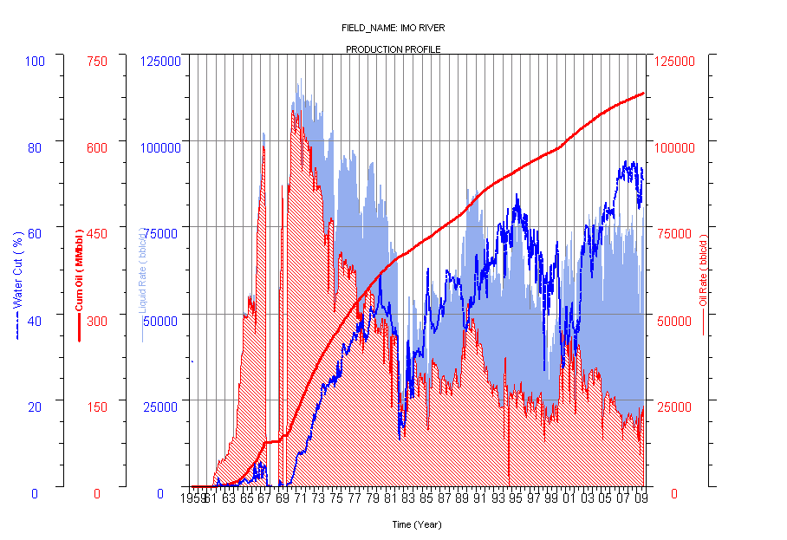
Imo River Field Summary
Location: 30km NE of PH
Disc/Onstream: 1959/61
Wells to date: 66 (5 aband.)
STOIIP/UR (MMstb) : 1677/1013 ??
Np @ 30.04.2017(MMstb): 692 ??
Cur Prod (Mbopd) : 16.5
3D Seismic: 1990/2003
FDP: 1997
Reservoir: 34(22)
Depth in ftss: 5000 – 11000

Slide 8
Imo River Production Performance
Civil war
Peak - 109Mpd
HZ wells drilling campaign – 10 new wells
Drilling campaign after 3D seismic
Increased WRM efforts

Slide 9
IMOR 2017 GL Well Stock Status: 2015-2017

Slide 10
Production: IMOR GAS LIFT SYSTEM SURFACE REVIEW
Current Realities
Deferment as @ End Jan 2018 -1.1Mbopd (0.3 Mbopd GL related)
Poor FLM coverage for Gaslift Distribution manifold.
Limited Lift gas Metering, control capability, and manual optimization
Improved deferment management of quit wells portfolio . Deferred wells portfolio??
Standardised process for opportunity Identification, maturation and trouble shooting in place but compliance an issue. Perhaps there is scope for optimisation
Sub optimal well designs and legacy completion strategy.
Limited collaboration and slow restoration of deferred wells.
Poor/Reactive Surveillance (Surface & Subsurface).
Improved Compressor uptime > 75% in Imor PU.

Slide 11
IMO RIVER GAS LIFT WELLS DEFERMENT PROFILE
Oil (bbl) | Gas (scf) | Reason
537,875 | 307,916 | Wellhead Equipment
210,763 | 65,651 | Pipeline
192,377 | 58,785 | Deliveryline/Trunkline
28,892 | 17,890 | Flowline
31,723 | 12,171 | AG Compressor
18,509 | 7,306 | Subsurf Safety Valve
20,305 | 7,044 | Facility Equipment Trips
5,747 | 4,632 | Manifold
2,052 | 794 | Reservior
1,694 | 678 | Gaslift Valve
61 | 17 | Flowline Safety Valve

Slide 12
Production: IMOR GAS LIFT SYSTEM SURFACE REVIEW
Identified data quality issues
No Lift gas measurements during GL wells routine tests (need to leverage on Agbada example)
Bulk gas lift metering issues: Instantaneous reading not seen, except over 24hrs.
Identified facility/process Integrity issues
vandalized well-heads, foaming and waxy wells.
Deferment Analysis: Wells, Gas lift sharing issues in wells, Gas lift valves in hole beyond cycle life of 2years. All GL wells in Imor have valves in hole without change out for over 6 years (impacted by scaling issues in tubing)
Reviewed AGG performance issues:
Critical spares availability, Power supply and operational issues.
Security: Third party interference IC’s etc) , Improvement of security around wellheads & flowlines
Identified Surface field Hardware issues
No MJR for the Gas lift manifold, hence no PM triggers from SAP; Low TEG unit uptime, hence liquid ingress into the GL manifold; Some FCVs in manual mode

Slide 13
Production: IMO RIVER GAS LIFT VALVES IN HOLE REVIEW

Slide 14
GAS LIFT SURVEILLANCE PROCESS
Shell’s Surveillance Strategy:
Support
Process
GL Champion
Spot
Problems
Implement
Changes
Convince
management
Field Techs, Well Analysts
Create GL
Team
Improve
Data & Systems
Analyze
Wells
Model
Performance
Field PTs, Gas Lift Team
Re-design/re-distribute

Slide 15
GAS LIFT SURVEILLANCE PROCESS
Role of Field Technicians/Well Analysts is to be the eyes, ears
and hands of the PTs and GL champions by:
Spotting problems (e.g. heading, low production)
Implementing and monitoring changes
Improving data
Monitoring and operating control systems
Improving implementation of the process
Field Technicians & Well
Analysts
Well heading
severely. I will
increase gas
and you
redesign it.

Slide 16
GAS LIFT SURVEILLANCE PROCESS
Role of Field PTs/Gas Lift Team is to manage the process by:
Analyzing and modeling the wells
Re-designing as necessary
Optimizing compressor utilization
Training the Field Technicians/Well Analysts
Maintaining the data
Keeping cost/benefits indicators
Co-ordinating wireline operations
Estimated
lift depth
8630’. A 150
bbl/d increase
expected.

Slide 17
GAS LIFT SURVEILLANCE PROCESS
Since gas lift can quietly get inefficient, gas lift surveillance should be proactive. Don’t wait until a well goes off production. Review each well plus the system itself several times a year.
Since there are no mechanical connections to the lift system in the well, spend time and money to gather quality information on the performance of each well. The proper use of this information will find inefficiencies and make money.
Industry examples (in and out of Shell) show the systematic optimizing of gas lift operations produce 5-15% gains in oil production at little cost -- the lowest cost per barrel of any oil in a field.
Inefficiency continues without a process to combat it. Surveillance should be a process not a project.

Slide 18
IMOR 2017 AGG AVAILABILITY/RELIABILITY PERFORMANCE 2017
Setting the Scene
1.4

Slide 19
AGG Availability: 2017 Performance
82% RUNNING AVERAGE

Slide 20
AGG Availability: 2017 Performance
Bad Actors
Recurring AC/DC Lube oil pump failures
Gas Gen failures
Instrument Air compressor failure
High Level 1st stage suction scrubber/ turbine fuel valve failed (Jan 17)
Lightning strike (May 17)
Compressor dry gas seal failure (Oct /Nov17)

Slide 21
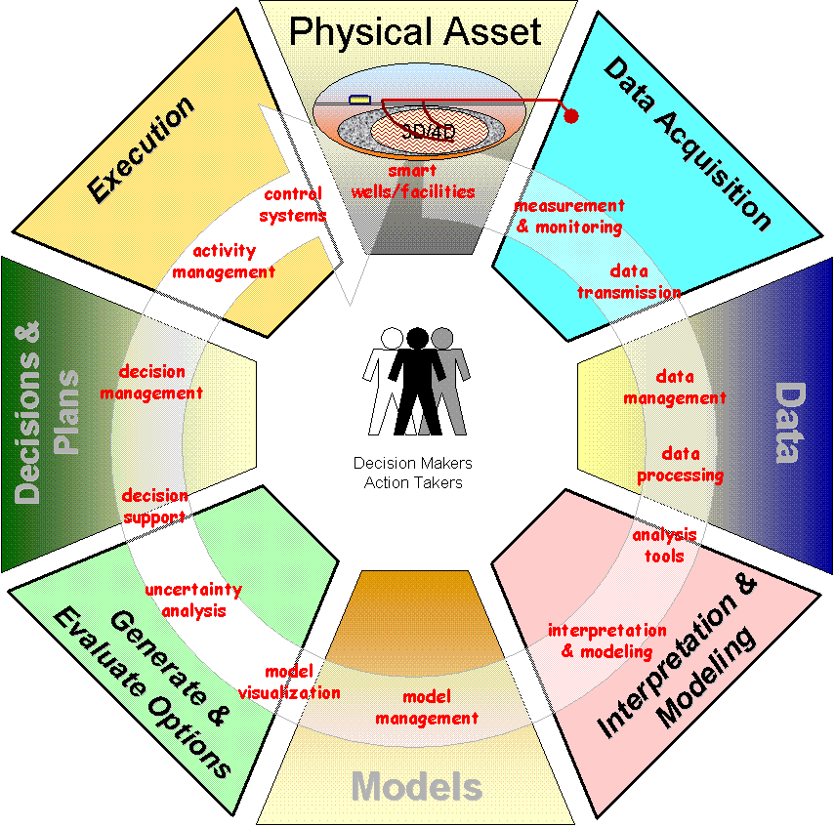
Imor PU Gas-Lift Health Check – Results (SAMPLE)
Competent hand within CWI, O&M Contractor + Operations
Good Dev - Well Services interface
Good Operations-Development interface
Installation of GLV, unloading and kick-off of wells with/without mandrels.
Compressor station availability/uptime at 95% ok
Manning level and lack of staff continuity in gaslift system operations.
Critical spares and sustainable procurement of parts for the IGPES compressor/gas plants
GL competence and staff motivation
Competencies in gaslift optimisation.
Availability of Well services barge
Security situation impacting on operations
Silted slots
Gas lift lines availability (Some lines required to be replaced)
Inability to run the two compressors the same time
Gas break-in/Foam in SV creating pump cavitation and low production
CAO SCADA unavailability hampering real time monitoring / Well testing
No updated gaslift system operating envelop for optimisation
Gaslift manifold in place (planned to maintain FCVsr)
xx MMscfd of gas(HP)) available for gaslift compression
Lift gas metering on individual wells available
Adequate no of pumps
Gaslift lines to wells in place; some leaking gaslines.
Vmonitor/CAO/SCADA not functional.
Gas metering Facility(No integrators)
Optimization of dual string completion.
Gaslift manifold desanding to prevent wet gas injection to the wells.
BHP surveys ( SG) done regularly.
Gauges are regularly calibrated
Test separator availability
Data gathering plan in place
USM available in flowstations.
Metering & Production allocation
Time lag btw sample acquisition and analysis at the lab & prod. Prog.
Concurrent well test not always done with sampling & BHP acquisition. GOR measurement suspect
CAO SCADA not available Real Time BS&W
BSW probes not available on test separators
No Capability for real Real time data capture and analysis
Kick-off gaslift in Imor field
Gas lift valves and GL lines installation plans
Integrated Asset Activity Plan available
Real time systems implementation plan
Winglue modelling course readily available for PT’s
Automated gaslift system plan in place
Plan & process in place to build WinGlue models
CAO SCADA plan in place
Procurement & Storage of parts and materials.
Updated Asset Reference Plan
Maintained focus on the corporate WRM initiative
Optimization/rationalization strategy for GL
Lift gas metering for individual wells.
EC available and in use (welltest data)
Availability of up-to-date well status diagram
Availability of temperature data.
Accuracy of data in the corporate BHP database
Quality of BSW data
Wellhead Pressure data (feedback not regular)
Injected Gas, measurement and optimisation
Winglue training for PT
Kick off astanding gas lift in wells with mandrels
Planning and selection of data acquisition candidates
Determine the size of the prize (impact of gas lift in the Asset)
Ranked list of opportunities
Real time acquisition of production data
Gaslift training for operations, maintenance and PTs
Contractors for GL optimisation
PROSPER models available
Winglue models.
UNISIM Models available for the flowstation
Gap model available.
MBAL available
IPSM available
Competent PTs for building WinGLUE models
Competence in analyzing BHP surveys
Skills development
Programming & operations
Winglue
Field ware etc
Real-time monitoring of gaslifted wells

Slide 22
IMO RIVER 2018 Targets
Where We Want to Be
2.0

Slide 23
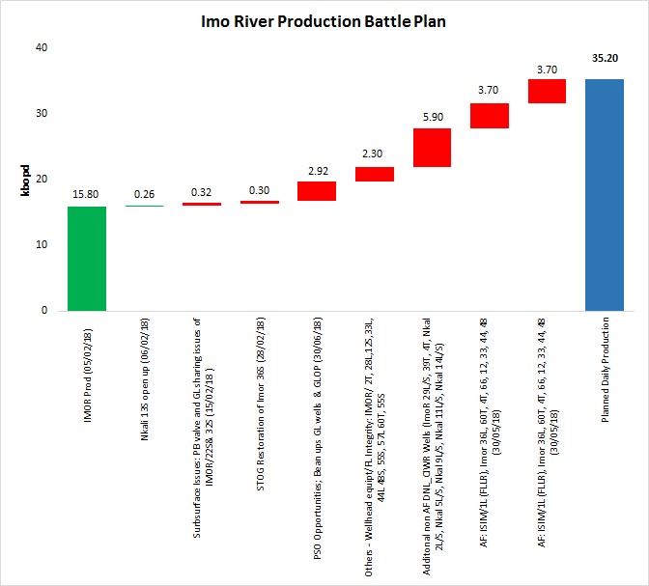
IMO RIVER PU PRODUCTION BATTLE PLAN
Source: ImoR PU strategy workshop, Wells potential BI rates and WRFM 2018

Slide 24
IPSC GROWTH PLAN AND ENABLERS
Source: ImoR PU strategy workshop, Wells potential BI rates and WRFM 2018

Slide 26
Opportunity/Risk Identification
Project : _____________ Team : _________________
Rank (H/M/L) | Opportunity | Comments
Rank (H/M/L) | Risk | Mitigations

Slide 27
SWOT Analysis
Build on STRENGTHS | Exploit OPPORTUNITIES
Resolve WEAKNESSES | Avoid THREATS

Slide 28
Idea Mapping
Project : _____________ Team : _________________
High value
Challenging implementation
Easy implementation
Low value

Slide 29
Action Planning
Project : _________________ Team : _________________
ID | Idea / Opportunity | Action ID | Action | Responsible Party | Start Date | End Date | Comments

